Slide 1
Chapter 1
An Overview of Computers and Programming Languages

Slide 2
Objectives (1 of 2)
In this chapter, you will:
Learn about different types of computers
Explore the hardware and software components of a computer system
Learn about the language of a computer
Learn about the evolution of programming languages
Examine high-level programming languages
Discover what a compiler is and what it does

Slide 3
Objectives (2 of 2)
Examine a C++ program
Explore how a C++ program is processed
Learn what an algorithm is and explore problem-solving techniques
Become aware of structured design and object-oriented design programming methodologies
Become aware of Standard C++, ANSI/ISO Standard C++, C++11, and C++14

Slide 4
Introduction
Without software, a computer is useless
Software is developed with programming languages
C++ is a programming language
C++ is suited for a wide variety of programming tasks

Slide 5
A Brief Overview of the History of Computers (1 of 3)
Early calculation devices
Abacus
Pascaline
Leibniz device
Jacquard’s weaving looms
Babbage machines: difference and analytic engines
Hollerith machine

Slide 6
A Brief Overview of the History of Computers (2 of 3)
Early computer-like machines
Mark I
Electronic Numerical Integrator and Calculator (ENIAC)
Von Neumann architecture
Universal Automatic Computer (UNIVAC)
Transistors and microprocessors

Slide 7
A Brief Overview of the History of Computers (3 of 3)
Categories of computers
Mainframe computers
Midsize computers
Micro computers (personal computers)

Slide 8
Elements of a Computer System
Two main components
Hardware
Software

Slide 9
Hardware
Central processing unit (C P U)
Main memory (M M) or random access memory (R A M)
Secondary storage
Input/output devices

Slide 10
Central Processing Unit and Main Memory (1 of 4)
Central processing unit
Brain of the computer
Most expensive piece of hardware
Operations
Carries out arithmetic and logical operations

Slide 11
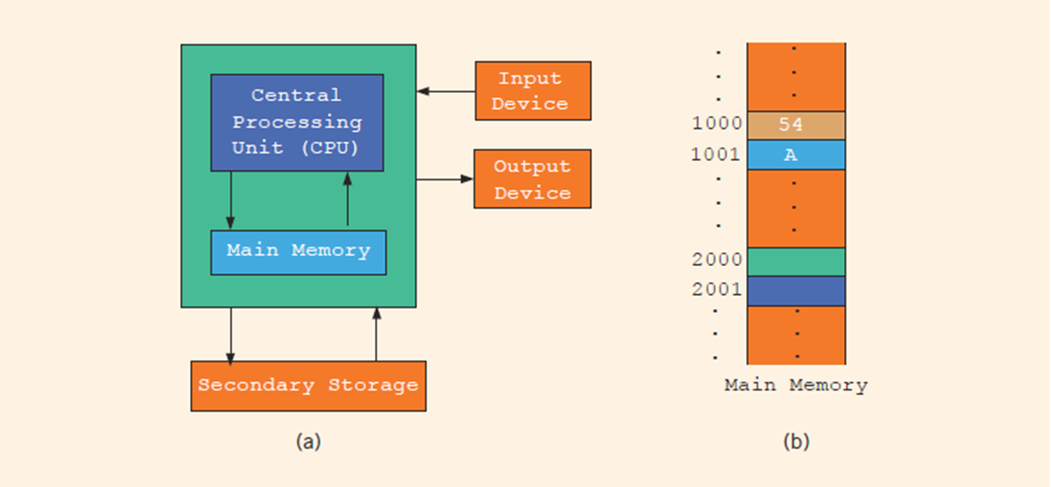
Central Processing Unit and Main Memory (2 of 4)
FIGURE 1-1 Hardware components of a computer and main memory

Slide 12
Central Processing Unit and Main Memory (3 of 4)
Random access memory (or main memory) is directly connected to the CPU
All programs must be loaded into main memory before they can be executed
All data must be brought into main memory before it can be manipulated
When computer power is turned off, everything in main memory is lost

Slide 13
Central Processing Unit and Main Memory (4 of 4)
Main memory is an ordered sequence of memory cells
Each cell has a unique location in main memory, called the address of the cell
Each cell can contain either a programming instruction or data

Slide 14
Secondary Storage
Secondary storage: device that stores information permanently
Examples of secondary storage
Hard disks
Flash drives
C D-R O Ms

Slide 15
Input/Output Devices
Input devices feed data and programs into computers
Keyboard
Mouse
Scanner
Camera
Secondary storage
Output devices display results
Monitor
Printer
Secondary storage

Slide 16
Software
Software are programs written to perform specific tasks
System programs control the computer
Operating system monitors the overall activity of the computer and provides services such as:
Memory management
Input/output activities
Storage management
Application programs perform a specific task
Word processors
Spreadsheets
Games

Slide 17
The Language of a Computer (1 of 4)
Analog signals: continuously varying continuous wave forms
Digital signals: sequences of 0s and 1s
Machine language: language of a computer
A sequence of 0s and 1s
Binary digit (bit): the digit 0 or 1
Binary code (binary number): a sequence of 0s and 1s

Slide 18
The Language of a Computer (2 of 4)
Byte: a sequence of eight bits
Kilobyte (KB):
ASCII (American Standard Code for Information Interchange)
128 characters
A is encoded as 1000001 (66th character)
The character 3 is encoded as 0110011 (51st character)
Number systems
The decimal system (base 10) is used in our daily life
The computer uses the binary (or base 2) number system

Slide 19
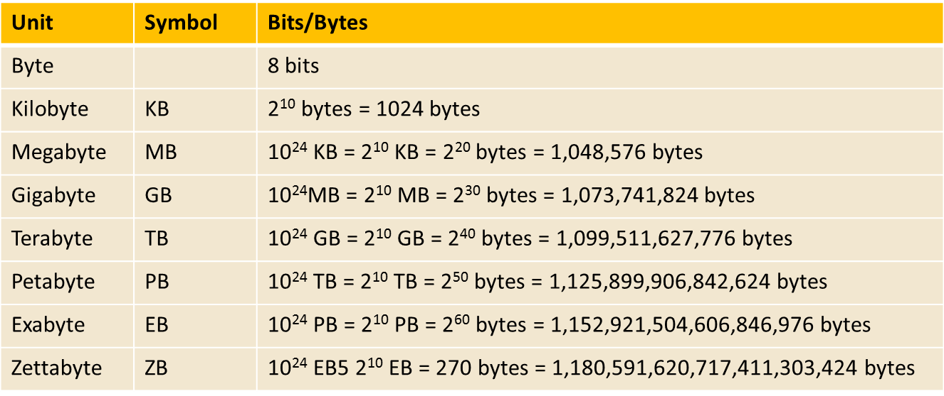
The Language of a Computer (3 of 4)
TABLE 1-1 Binary Units

Slide 20
The Language of a Computer (4 of 4)
Unicode is another coding scheme
65,536 characters
Two bytes (16 bits) to store a character

Slide 21
The Evolution of Programming Languages (1 of 3)
Early computers were programmed in machine language
To calculate wages = rate * hours in machine language:
100100 010001 //Load
100110 010010 //Multiply
100010 010011 //Store

Slide 22
The Evolution of Programming Languages (2 of 3)
Assembly language instructions are mnemonic
Instructions are written in an easy-to-remember form
An assembler translates a program written in assembly language into machine language
Using assembly language instructions, wages = rate * hours can be written as:
LOAD rate
MULT hours
STOR wages

Slide 23
The Evolution of Programming Languages (3 of 3)
High-level languages include Basic, FORTRAN, COBOL, C, C++, C#, Java, and Python
Compiler: translates a program written in a high-level language into machine language
In C++, the weekly wages equation can be written as:
wages = rate * hours;

Slide 24
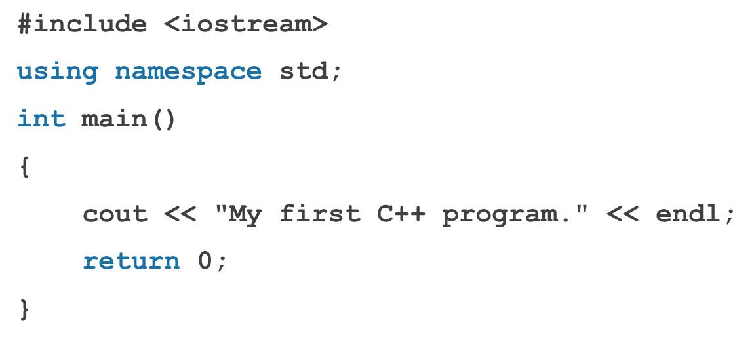
Processing a C++ Program (1 of 4)
Sample Run:
My first C++ program.

Slide 25
Processing a C++ Program (2 of 4)
Steps needed to process a C++ program
Use a text editor to create the source code (source program) in C++
Include preprocessor directives
Begin with the symbol # and are processed by the preprocessor
Use the compiler to:
Check that the program obeys the language rules
Translate the program into machine language (object program)
Use an integrated development environment (IDE) to develop programs in a high-level language
Programs such as mathematical functions are available
The library contains prewritten code you can use
A linker combines object program with other programs in the library to create executable code
The loader loads executable program into main memory
The last step is to execute the program

Slide 26
Processing a C++ Program (3 of 4)
IDEs are quite user friendly
Compiler identifies the syntax errors and also suggests how to correct them
Build or Rebuild is a simple command that links the object code with the resources used from the IDE

Slide 27
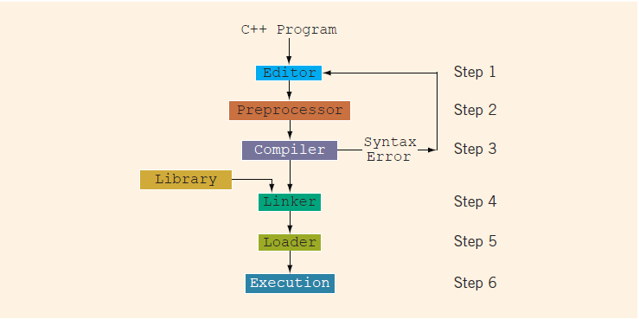
Processing a C++ Program (4 of 4)
FIGURE 1-2 Processing a C++ program

Slide 28
Editor: Writing the C++ program (not part of the compilation process itself).
Preprocessor: Preparing the code (e.g., macro expansion, including header files).
Compiler: Translating the preprocessed code into assembly language and then into an object file.
Linker: Linking object files and libraries to create an executable.
Loader: Loading the executable into memory (not part of the compilation process itself).
Execution: Running the program (not part of the compilation process itself).

Slide 29
gcc-c
Preprocessor (Step 2): The source code is preprocessed.
Compiler (Step 3): The preprocessed code is compiled into an object file (e.g., .o or .obj)
What gcc –c does not do
It does not perform the linking step (Step 4). Therefore, no executable is created. It stops after generating the object file.
gcc -o
Preprocessor (Step 2): The source code is preprocessed.
Compiler (Step 3): The preprocessed code is compiled into an object file.
Linker (Step 4): The object file is linked with necessary libraries to produce an executable.
What gcc –o does
It performs all steps from preprocessing through linking. The result is an executable file.

Slide 30
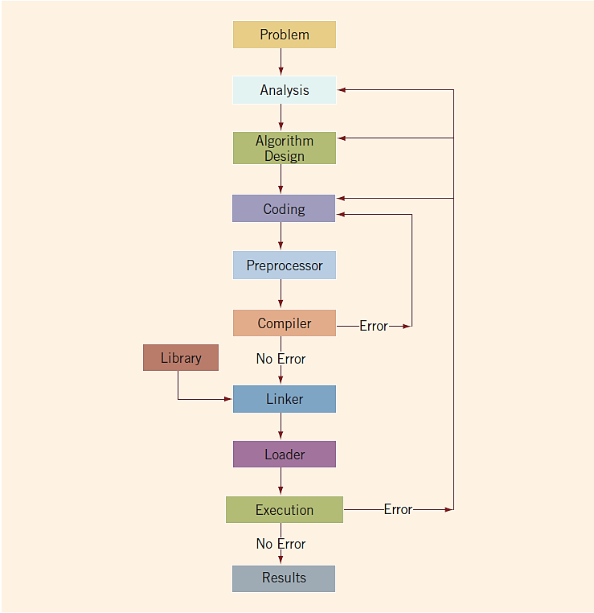
Programming with the Problem Analysis–Coding–Execution Cycle
FIGURE 1-3 Problem analysis–coding–execution cycle
Programming is a process of problem solving
An algorithm is a step-by-step problem-solving process
A solution is achieved in a finite amount of time

Slide 31
The Problem Analysis–Coding–Execution Cycle (1 of 5)
Step 1: Analyze the problem
Outline the problem and its requirements
Design steps (algorithm) to solve the problem
Step 2: Implement the algorithm
Implement the algorithm in code
Verify that the algorithm works
Step 3: Maintain the program
Use and modify the program if the problem domain changes

Slide 32
The Problem Analysis–Coding–Execution Cycle (2 of 5)
Analyze the problem using these steps:
Step 1: Thoroughly understand the problem and all requirements
Step 2: Understand the problem requirements
Does program require user interaction?
Does program manipulate data?
What is the output?
Step 3: If complex, divide the problem into subproblems
Analyze and design algorithms for each subproblem
Check the correctness of algorithm
Test the algorithm using sample data
Some mathematical analysis might be required

Slide 33
The Problem Analysis–Coding–Execution Cycle (3 of 5)
Once the algorithm is designed and correctness is verified
Write the equivalent code in high-level language
Enter the program using a text editor

Slide 34
The Problem Analysis–Coding–Execution Cycle (4 of 5)
Run code through the compiler
If compiler generates errors
Look at code and remove errors
Run code again through compiler
If there are no syntax errors
Compiler generates equivalent machine code
Link machine code with the system’s resources
Performed by the linker

Slide 35
The Problem Analysis–Coding–Execution Cycle (5 of 5)
Once compiled and linked, the loader can place program into main memory for execution
The final step is to execute the program
Compiler guarantees that the program follows the rules of the language
Does not guarantee that the program will run correctly

Slide 36
Example 1-1 (1 of 2)
Design an algorithm to find the perimeter and area of a rectangle
The perimeter and area of the rectangle are given by the following formulas:
perimeter = 2 * (length + width)
area = length * width

Slide 37
Example 1-1 (2 of 2)
Algorithm
Get the length of the rectangle
Get the width of the rectangle
Find the perimeter with this equation:
perimeter = 2 * (length + width)
Find the area with this equation:
area = length * width

Slide 38
#include <iostream>
using namespace std;
int main() {
// Declare variables to hold the length, width, perimeter, and area
double length, width, perimeter, area;
// Input the length and width from the user
cout << "Enter the length of the rectangle: ";
cin >> length;
cout << "Enter the width of the rectangle: ";
cin >> width;
// Calculate the perimeter
perimeter = 2 * (length + width);
// Calculate the area
area = length * width;
// Output the results
cout << "Perimeter of the rectangle: " << perimeter << endl;
cout << "Area of the rectangle: " << area << endl;
return 0;
}

Slide 39
Example 1-5 (1 of 4)
Calculate each student’s grade
There are 10 students in a class
Each student has taken five tests
Each test is worth 100 points
Design algorithms to:
Calculate the grade for each student and class average
Find the average test score
Determine the grade
Use the provided data: students’ names and test scores

Slide 40
Example 1-5 (2 of 4)
Algorithm to determine the average test score
Get the five test scores
Add the five test scores
The sum of the test scores is represented by sum
Suppose average stands for the average test score:
average = sum / 5;

Slide 41
Example 1-5 (3 of 4)
Algorithm to determine the grade:
if average is greater than or equal to 90
grade = A
otherwise
if average is greater than or equal to 80 and less than 90
grade = B
otherwise
if average is greater than or equal to 70 and less than 80
grade = C
otherwise
if average is greater than or equal to 60 and less than 70
grade = D
otherwise
grade = F

Slide 42
Example 1-5 (4 of 4)
Main algorithm is presented below:
totalAverage = 0;
Repeat the following for each student:
Get student’s name
Use the algorithm to find the average test score
Use the algorithm to find the grade
Update totalAverage by adding current student’s average test score
Determine the class average as follows:
classAverage = totalAverage / 10

Slide 43
Programming Methodologies
Two popular approaches to programming design
Structured
Object-oriented

Slide 44
Structured Programming
Structured design
Involves dividing a problem into smaller subproblems
Structured programming
Involves implementing a structured design
The structured design approach is also called:
Top-down (or bottom-up) design
Stepwise refinement
Modular programming

Slide 45
Object-Oriented Programming (1 of 3)
Object-oriented design (OOD)
Identify components called objects
Determine how objects interact with each other
Specify relevant data and possible operations to be performed on that data
Each object consists of data and operations on that data

Slide 46
Object-Oriented Programming (2 of 3)
An object combines data and operations on the data into a single unit
A programming language that implements OOD is called an object-oriented programming (OOP) language
To design and use objects, you must learn how to:
Represent data in computer memory
Manipulate data
Implement operations

Slide 47
Object-Oriented Programming (3 of 3)
To create operations:
Write algorithms and implement them in a programming language
Use functions to implement algorithms
Learn how to combine data and operations on the data into a single unit called a class
C++ was designed to implement OOD
OOD is used with structured design

Slide 48
ANSI/ISO Standard C++
C++ evolved from C
C++ designed by Bjarne Stroustrup at Bell Laboratories in early 1980s
Many different C++ compilers were available
C++ programs were not always portable from one compiler to another
In mid-1998, ANSI/ISO C++ language standards were approved
Second standard, called C++11, was approved in 2011

Slide 49
Quick Review (1 of 3)
A computer is an electronic device that can perform arithmetic and logical operations
A computer system has hardware and software components
The central processing unit (CPU) is the brain
Primary storage (MM) is volatile; secondary storage (e.g., disk) is permanent
The operating system monitors overall activity of the computer and provides services
There are various kinds of languages

Slide 50
Quick Review (2 of 3)
Compiler: translates high-level language into machine code
Algorithm:
Step-by-step problem-solving process
Arrives at a solution in a finite amount of time
Problem-solving process
Analyze the problem and design an algorithm
Implement the algorithm in code
Maintain the program

Slide 51
Quick Review (3 of 3)
Structured design
Problem is divided into smaller subproblems
Each subproblem is solved
Combine solutions to all subproblems
Object-oriented design (OOD) program: a collection of interacting objects
Object: data and operations on those data

